Slide 1
Medicare 101 Marketplace & Medicaid Transitions
Janice Meinert
Kyle Fisher
kfisher@phlp.org
Feb/March 2017

Slide 2
Topics
Medicare Basics
Eligibility and Enrollment
Original Medicare vs Medicare Advantage
Transitions to Medicare
From Marketplace Coverage
From Medicaid
Affordability Programs
Medicare Cost Sharing
Medicare Savings Program
Extra Help (Rx)
Notes:
Medicare in 3 parts – overview / transitions / affording it
Poll audience – how many do assist patients medicaid elig & enrollment?

Slide 3
Medicare Basics
Who qualifies?
What do they get?
How do they enroll?

Slide 4
Who Gets Medicare?
Someone is eligible for Medicare if they:
Are age 65 or older, or
Have received Social Security Disability (SSDI) benefits for two years, or
Have End-Stage Renal Disease (ESRD) and are receiving dialysis or have had a kidney transplant
Notes:
1st two – extremely common
Last bullet (2 avenues) – much less common / ALS especially
*Amyotrophic Lateral Sclerosis (ALS) alone not enough / tied to SSD reciept, no waiting period

Slide 5
What does Medicare cover?
Part A
Hospital Insurance
Part B
Medical Insurance
Part C
Medicare Advantage Plans
Includes Parts A and B, sometimes Part D
Part D
Pharmacy Coverage
Notes:
Medicare covers many types of services, and you have options for how you get your Medicare coverage. Medicare has 4 parts:
Part A (Hospital Insurance) helps pay for inpatient hospital stays, skilled nursing facility care, home health care, and hospice care.
Part B (Medical Insurance) helps cover medically necessary services like doctor visits and outpatient care. Part B also covers many preventive services (including screening tests and shots), diagnostic tests, some therapies, and durable medical equipment like wheelchairs and walkers. Together, Part A and Part B are also referred to as “Original Medicare.”
Part C (Medicare Advantage [MA]) is another way to get your Medicare benefits. It combines Parts A and B, and sometimes Part D (prescription drug coverage). MA Plans are managed by private insurance companies approved by Medicare. These plans must cover medically necessary services. However, plans can charge different copayments, coinsurance, or deductibles for these services than Original Medicare.
Part D (Medicare Prescription Drug Coverage) helps pay for outpatient prescription drugs. Part D may help lower your prescription drug costs and protect you against higher costs in the future.

Slide 6
Enrollment – Parts A & B
Enrollment is generally automatic, unless:
Individual is not receiving Social Security benefits when they turn 65, or
Individual has ESRD (different enrollment rules apply)
Social Security Administration
handles Parts A and B enrollment
Individuals who decline Medicare Parts A and B when they are first eligible may have to:
Pay more for their coverage
Wait for their coverage to start
Notes:
Penalties: Part B = 10% increase per year

Slide 7
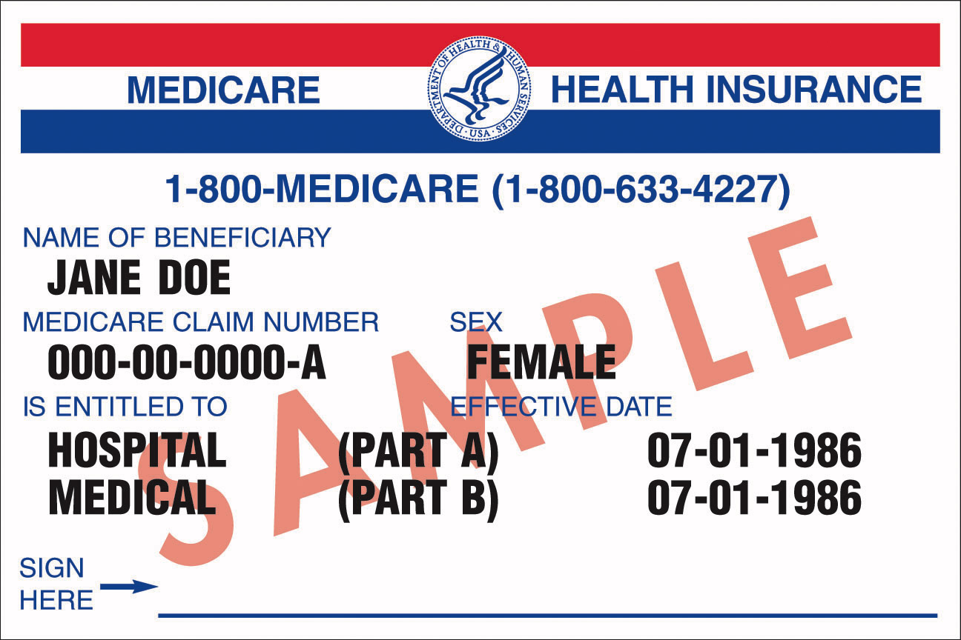
Medicare Coverage Options
Original Medicare
OR
Medicare Advantage Plan
Medicare Advantage –
Medical Only plan
(Parts A and B only)
Medicare Advantage
–
Including prescription drug coverage
(Parts A, B, & D)
Jane Doe
Medigap
(or other secondary coverage)
+
Part D Plan
Notes:
How’s it work? What’s the delivery mechanism? - aka: FFS or MCO
Among dual-eligibles – about 2/3 in Original, 1/3 in Med Adv (as of 2014?)
with Part D: various teirs and formularies, huge differences in pricing (use tool on Medicare website to choose a plan)

Slide 8
Part C: Medicare Advantage
Health plans approved by Medicare
Run by private insurance companies
People use their Medicare Advantage plan card (and not the red, white, and blue Medicare card)
Have to use network providers
Plans determine cost-sharing & extra benefits
Must cover all Part A and Part B covered services
May cover extra benefits like vision care, dental care
May cover prescription drugs
Notes:
Med Adv plans can offer extra goodies – also help w/ costsharing
- instead of 20% co-insurance (after doc visit), might have a monthly premium and set copay.
But -- trade-offs – fewer doctors, also at mercy of HMO for prior auth

Slide 9
Part D: Drug Coverage
Coverage offered through (1) stand-alone prescription drug plans or (2) a Medicare Advantage Plan
There is no “Original Medicare” option for Part D
Individuals with “creditable coverage” (through the VA, or retiree coverage, e.g.) may not need Part D
In 2016, Pennsylvania has 26 stand-alone drug plans available
See www.Medicare.gov or the 2016 Medicare & You Handbook
Drug coverage and pharmacy network varies
Each plan has a list of covered drugs, and its own prior auth rules
Plans may have “preferred pharmacies” where costs are lower
Notes:
In great public vs private debate – this one a bit like Marketplace or exchange / public monies flow through private plans
- created by Pres GW Bush, went into effect 2006

Slide 10
Enrollment - Parts C & D
Enroll directly with the plan or through Medicare
(1-800-633-4227; www.medicare.gov)
Individuals can change their Part C and Part D plan once a year
Annual Enrollment Period: October 15-December 7
Coverage starts January 1st
Individuals who decline Part D when first eligible may face late enrollment penalties

Slide 11
Medigap Basics
“Medigap” plans are Medicare Supplement Insurance Policies (sold by private companies)
Secondary insurance to Original Medicare
Plans are standardized; all plans with same letter have same coverage but costs differ by company
Coverage for Part A and B deductibles and coinsurance varies by plan type
Plan information available on www.medicare.gov
Notes:
See slide 7 – if stick with original + PDP, most consumers also want medigap / supplemental to wraparound Medicare A & B

Slide 12
Transitions
From Marketplace
Or Medicaid

Slide 13
From Marketplace
Transitioning from Marketplace Coverage to Medicare
General Rule:
Marketplace coverage & Medicare do not mix
Lose all Marketplace subsidies (APTC and CSR) when they qualify for Medicare
Most should cancel their FFM coverage after Medicare begins
Have option to continue FFM coverage at full price
Marketplace coverage is not a supplement to Medicare
Notes:
- oil and water! Lots of older adults, in particular, confused – think need FFM coverage to avoid tax penalties, e.g.
-- Opposite scenario–Medicare enrollees cannot purchase FFM coverage; unlawful for FFM insurer to sell duplicate coverage, even at full price

Slide 14
From Marketplace
Exception:
Individuals who have to pay a Part A premium can instead choose Marketplace coverage with subsidies
Requires they not yet be enrolled (or disenroll) in Medicare
Risks:
By declining Medicare Part A and Part B, they may face later enrollment penalties & coverage gaps
Notes:
This is somewhat rare – most people qualify for free Part A
To avoid prohibition on duplicate coverage to Medicare beneficiaries
- penalties would be when try to enroll later; some scenarios – artist / low income, ocntinue to work pay into system, likely to qualify for premium-fee Part A
- would then lost APTCs, and face late enrollment penalties

Slide 15
From Marketplace
What about consumers who declined Medicare because they had Marketplace coverage?
Do they have really have to wait until July for Part B?
And pay a 10% penalty?
Ask SSA for “Equitable Relief”
In writing, highlight confusion & any misinformation received
especially if from SSA, Marketplace, or Marketplace insurer
Can refer consumers to APPRISE for help;
3/31/17 deadline
See the Center for Medicare Rights tip sheet
Notes:
- CMS has some sympathy for these cases –
- limited window for relief – ends March 31, 2017 (check w/ EG)

Slide 16
From Medicaid
Transitioning from Medicaid to Medicare
General Rule:
Medicaid & Medicare can mix
Depends on category of Medicaid coverage
Coverage through Medicaid expansion will end when the consumer becomes eligible for Medicare
To keep Medicaid once Medicare starts, these consumers need to qualify under a different category

Slide 17
From Medicaid
Other Medicaid categories remain available though
Such as Healthy Horizons and MAWD
“Dual-eligibles” have advantage of:
Medicaid benefits like dental coverage and transportation
Medicaid becomes a comprehensive secondary insurance
Cost-sharing protections: no deductibles, small copays
DHS moves dual-eligibles from managed care into Fee-for-Service MA (ACCESS card)
Until Community HealthChoices is implemented
Dual-eligibles stay in behavioral health MCOs now
Notes:
** use examples – extremely common – switch from MA MCO to Medicare & MA FFS, think no longer any Rx pharmacy coverage

Slide 18
Medicaid – Adult Category
Adults age 19-64
Income under 138% FPL
Cannot qualify for Medicare
No asset test
 | Household of 1 | Household of 2 | Household of 3 | Household of 4
138% FPL (2017) Monthly | $1,387 | $1,868 | $2,349 | $2,829
Annually | $16,643 | $22,411 | $28,180 | $33,948
Notes:
Recall – bulk of Medicaid consumers you work with -> expansion or adult category
-- age, income, one other criterion – no Medicare

Slide 19
Medicaid – Healthy Horizons
First option for low-income Medicare beneficiaries
Two ways to qualify:
Age 65+ <or> 2. Disability
Plus disregards!
Resource Limit: $2000 (HH of 1)
$3000 (HH of 2+) See MAEH Ch. 319
Household Size | Monthly | Annual
HH of 1 | $1,005 | $12,060
HH of 2 | $1,354 | $16,240
Notes:
Note lower than 138, expansion category – and harder to get in

Slide 20
Medical Assistance for Workers w/ Disabilities
MAWD (250% FPL; 2017)
Age 16-64
Requires 5% premium
Plus income disregards!
Resource Limit: $10,000
Household Size | Monthly | Annual
HH of 1 | $2,513 | $30,150
HH of 2 | $3,383 | $40,600

Slide 21
Medicare Cost Sharing
Medicare Savings Program
&
Low income subsidy

Slide 22
Medicare Cost Sharing (2017)
Part A
Premium = $0 (for most); ≤ $413/month (otherwise)
Deductible = $1,316/benefit period
Copays=$0/day (1-60) $322/day (61-90); $644/day (90-150)
Part B
Premium = $104.90/month; $134/month (new enrollees)
Deductible = $183/year
Coinsurance = typically 20%
Part D
Cost Sharing = varies by plan
Premium = vary ($18-150/month)
Notes:
In short – Medicare is expensive!
- 20% costsharing can be huge for clients who need to see doctors/specialists, have tests done, et cet.
*Part A – these costs for hospital stays / different rules for NH -- “benefit period” runs 60 days post-discharge
*Part B premiums higher for ind’ls over $85,000 /year

Slide 23
Affordability Programs
Medicare Savings Programs (MSP)
Payment of Part B premium
Also known as Medicare “Buy-in”
Administered through Medicaid, local CAOs
For people with lowest incomes (< 100% FPL)
Also covers Medicare Part A and B deductibles and coinsurance
Income & Resource limits
Single: income < $1,357/mo; resources < $7,390
Married: income < $1,868/mo; resources < $11,900
*Not all income/resources count

Slide 24
Affordability Programs
“Extra Help” with Medicare Part D Costs
Limits drug costs regardless of what Part D plan someone has
Helps with premiums, deductible, and copays
Medicaid recipients automatically qualify for “extra help”
Everyone else must apply (through SSA) and meet income and resource limits
Income & Resource Limits
Single: income < $1,508/mo; resources < $13,820
Married: income < $2,030/mo; resources < $27,600
* Not all income/resources count

Slide 25
Sources of Help
APPRISE (1-800-783-7067)
Helps people understand Medicare coverage;
Helps with Medicare plan choices;
Helps people apply for Medicare Savings Programs and Extra Help;
Helps resolve Medicare problems
Medicare (1-800-633-4227)
Can answer questions about Medicare and help research Medicare Part C and Part D Plans.
1-800-MEDICARE (1-800-633-4227) or www.medicare.gov
PHLP (1-800-274-3258)
Can provide basic information about Medicare and screen people for Medicare Savings Programs/Extra Help;
Can help resolve certain problems for dual-eligibles
Notes:
APPRISE has funding to help do MSP and LIS outreach and enrollments; they might refer people to an Application Center…

Slide 26
Resources
Medicare & You 2017 Handbook
https://www.medicare.gov/pubs/pdf/10050-Medicare-and-You.pdf
HC.gov – Changing from Marketplace to Medicare
https://www.healthcare.gov/medicare/changing-from-marketplace-to-medicare/
Medicare Rights Center: Equitable Relief
https://www.medicarerights.org/PartB-Enrollment-Toolkit/Equitable-Relief.pdf
PHLP Factsheets on MSP and Extra Help
http://www.phlp.org/home-page/resources/medicare/medicare-all
PHLP Medical Assistance Eligibility Manual
http://www.phlp.org/wp-content/uploads/2016/02/Eligibility-Manual-Rev.-2016.pdf
PHLP Helpline: 1-800-274-3258
Kfisher@phlp.org

